Slide 1

Programming Languages
Third Edition
Chapter 11
Abstract Data Types and Modules

Slide 2
Objectives
Understand the algebraic specification of abstract data types
Be familiar with abstract data type mechanisms and modules
Understand separate compilation in C, C++ namespaces, and Java packages
Be familiar with Ada packages
Be familiar with modules in ML
Programming Languages, Third Edition

Slide 3
Objectives (cont’d.)
Learn about modules in earlier languages
Understand problems with abstract data type mechanisms
Be familiar with the mathematics of abstract data types
Programming Languages, Third Edition

Slide 4
Introduction
Data type: a set of values, along with certain operations on those values
Two kinds of data types: predefined and user-defined
Predefined data types:
  Insulate the user from the implementation, which is machine dependent
  Manipulated by a set of predefined operations
  Use is completely specified by predetermined semantics
Programming Languages, Third Edition

Slide 5
Introduction (cont’d.)
User-defined data types:
  Built from data structures using language's built-in data types and type constructors
  Internal organization is visible to the user
  No predefined operations
Would be desirable to have a mechanism for constructing data types with as many characteristics of a built-in type as possible
Abstract data type (or ADT): a data type for constructing user-defined data types
Programming Languages, Third Edition

Slide 6
Introduction (cont’d.)
Important design goals for data types include modifiability, reusability, and security
Encapsulation:
  Collection of all definitions related to a data type in one location
  Restriction on the use of the type to the operations defined at that location
Information hiding: separation and suppression of implementation details from the data type’s definition
Programming Languages, Third Edition

Slide 7
Introduction (cont’d.)
There is sometimes confusion between a mechanism for constructing types and the mathematical concept of a type
Mathematical models are often given in terms of an algebraic specification
Object-oriented programming emphasizes the concept of entities to control their own use during execution
Abstract data types do not provide the level of active control that represents true object-oriented programming
Programming Languages, Third Edition

Slide 8
Introduction (cont’d.)
The notion of an abstract data type is independent of the language paradigm used to implement it
Module: a collection of services that may or may not include data type(s)
Programming Languages, Third Edition

Slide 9
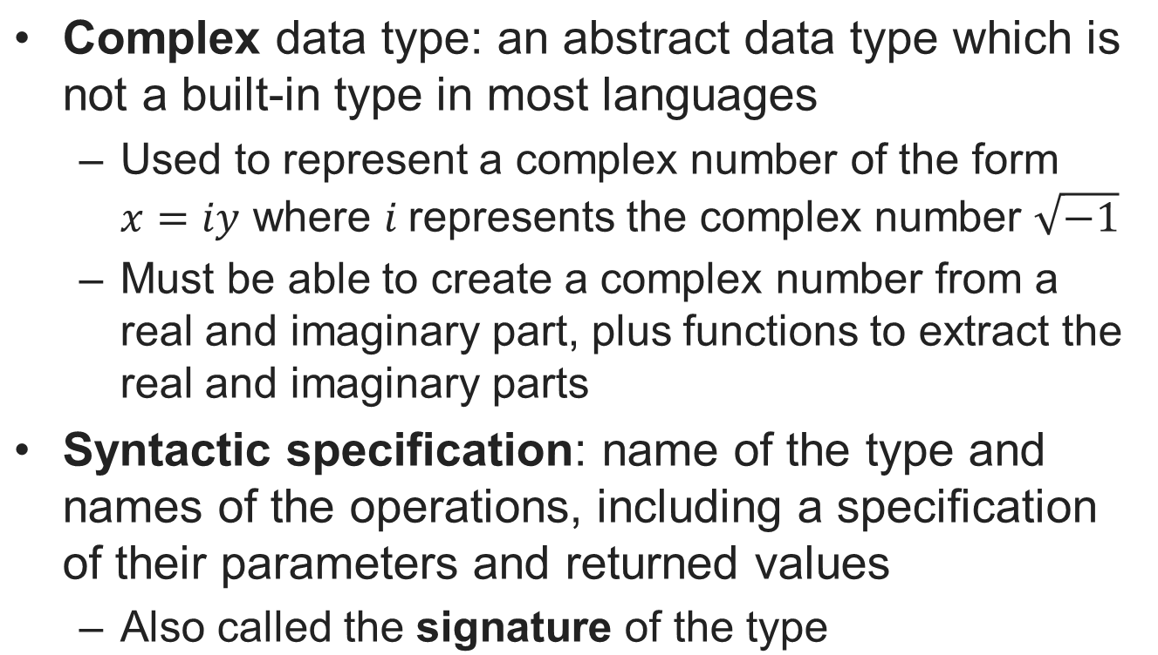
The Algebraic Specification of Abstract Data Types
Programming Languages, Third Edition

Slide 10
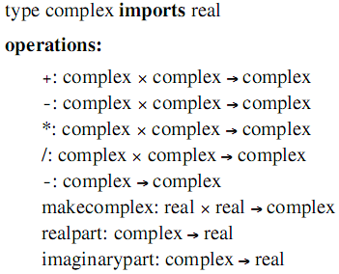
The Algebraic Specification of Abstract Data Types (cont’d.)
Function notation is used to specify the operations of the data type f:X→Y
Signature for complex data type:
Programming Languages, Third Edition

Slide 11
The Algebraic Specification of Abstract Data Types (cont’d.)
This specification lacks any notion of semantics, or the properties that the operations must actually possess
In mathematics, semantic properties of functions are often described by equations or axioms
  Examples of axioms: associativity, commutative, and distributive laws
Axioms can be used to define semantic properties of complex numbers, or the properties can be derived from those of the real data type
Programming Languages, Third Edition

Slide 12

The Algebraic Specification of Abstract Data Types (cont’d.)
Example: complex addition can be based on real addition
  This allows us to prove arithmetic properties of complex numbers using the corresponding properties of reals
A complete algebraic specification of type complex combines signature, variables, and equational axioms
  Called the algebraic specification
Programming Languages, Third Edition

Slide 13
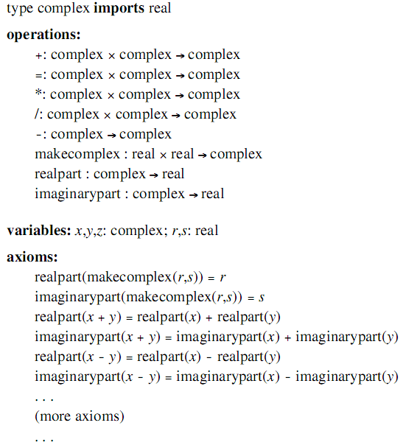
Programming Languages, Third Edition

Slide 14
The Algebraic Specification of Abstract Data Types (cont’d.)
The equational semantics give a clear indication of implementation behavior
Finding an appropriate set of equations, however, can be difficult
Note that the arrow in the syntactic specification separates a function’s domain and range, while equality is of values returned by functions
A specification can be parameterized with an unspecified data type
Programming Languages, Third Edition

Slide 15
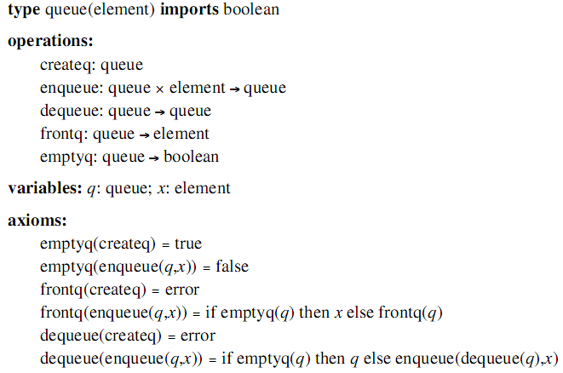
The Algebraic Specification of Abstract Data Types (cont’d.)
Programming Languages, Third Edition

Slide 16
The Algebraic Specification of Abstract Data Types (cont’d.)
createq: a constant
  Could be viewed as a function of no parameters that always returns the same value – that of a new queue that has been initialized to empty
Error axioms: axioms that specify error values
  Provide limitations on the operations
  Example: frontq(createq) = error
Note that the dequeue operation does not return the front element; it simply throws it away
Programming Languages, Third Edition

Slide 17
The Algebraic Specification of Abstract Data Types (cont’d.)
Equations specifying the semantics of the operations can be used as a specification of the properties of an implementation
There is no mention of memory or of assignment
  These specifications are in purely functional form
In practice, abstract data type implementations often replace the functional behavior with an equivalent imperative one
Finding an appropriate axiom set for an algebraic specification can be difficult
Programming Languages, Third Edition

Slide 18
The Algebraic Specification of Abstract Data Types (cont’d.)
Can make some judgments about the kind and number of axioms needed by looking at the syntax of the operations
Constructor: an operation that creates a new object of the data type
Inspector: an operation that retrieves previously constructed values
  Predicates: return Boolean values
  Selectors: return non-Boolean values
In general, we need one axiom for each combination of an inspector with a constructor
Programming Languages, Third Edition

Slide 19
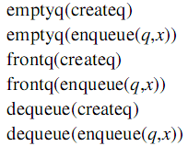
The Algebraic Specification of Abstract Data Types (cont’d.)
Example:
  The queue’s axiom combinations are:
  Indicates that six rules are needed
Programming Languages, Third Edition

Slide 20
Abstract Data Type Mechanisms
A mechanism for expressing abstract data types must have a way of separating the signature of the ADT from its implementation
  Must guarantee that any code outside the ADT definition cannot use details of the implementation and must operate on a value of the defined type only through the provided operations
ML has a special ADT mechanism called abstype
Programming Languages, Third Edition

Slide 21
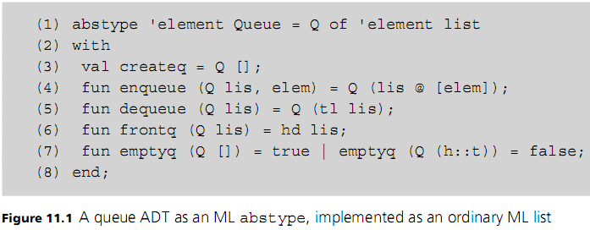
Abstract Data Type Mechanisms (cont’d.)
Programming Languages, Third Edition

Slide 22
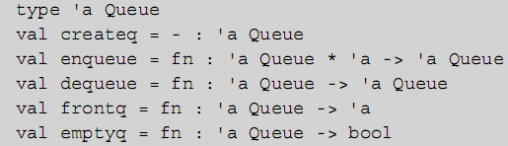
Abstract Data Type Mechanisms (cont’d.)
ML translator responds with a description of the signature of the type:
Since ML has parametric polymorphism, the Queue type can be parameterized by the type of the element to be stored in the queue
Programming Languages, Third Edition

Slide 23
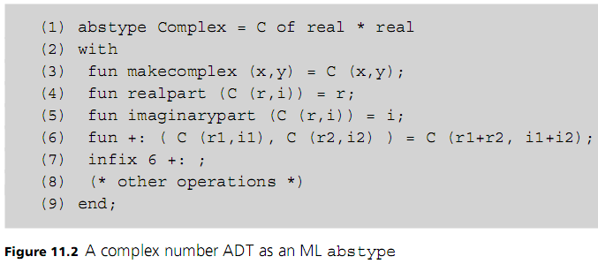
Abstract Data Type Mechanisms (cont’d.)
Programming Languages, Third Edition

Slide 24
Abstract Data Type Mechanisms (cont’d.)
ML allows user-defined operators, called infix functions
  Can use special symbols
  Cannot reuse the standard operator symbols
Example: we have defined the addition operator on complex number to have the name +: as an infix operator with a precedence level of 6 (same as built-in additive operators)
Programming Languages, Third Edition

Slide 25
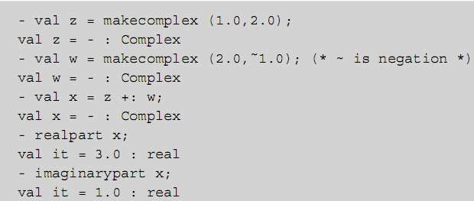
Abstract Data Type Mechanisms (cont’d.)
The Complex type can be used as follows:
Programming Languages, Third Edition

Slide 26
Modules
A pure ADT mechanism does not address the entire range of situations where an ADT-like abstraction mechanism is useful in a language
It makes sense to encapsulate the definitions and implementations of a set of standard functions that are closely related and hide the implementation details
  Such a package is not associated directly with a data type and does not fit the format of an ADT mechanism
Programming Languages, Third Edition

Slide 27
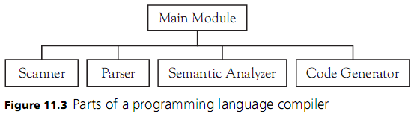
Modules (cont’d.)
Example: a complier is a set of separate pieces
Module: a program unit with a public interface and a private implementation
As a provider of services, modules can export any mix of data types, procedures, variables, and constants
Programming Languages, Third Edition

Slide 28
Modules (cont’d.)
Modules assist in the control of name proliferation
  They usually provide additional scope features
A module exports only names that its interface requires, keeping hidden all others
Names are qualified by the module name to avoid accidental name clashes
  Typically done by using the dot notation
A module can document dependencies on other modules by requiring explicit import lists whenever code from other modules is used
Programming Languages, Third Edition

Slide 29
Separate Compilation in C and C++
C does not have any module mechanisms
  Has separate compilation and name control features that can be used to simulate modules
Typical organization of a queue data structure in C:
  Type and function specifications in a header file queue.h would include type definitions and function declarations without bodies (called prototypes)
  This file is used as a specification of the queue ADT by textually including it in client code and implementation code using the C preprocessor #include directive
Programming Languages, Third Edition

Slide 30
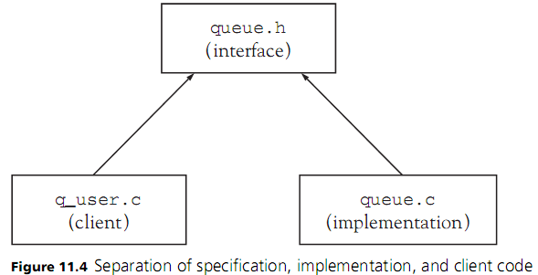
Separate Compilation in C and C++ (cont’d.)
Programming Languages, Third Edition

Slide 31
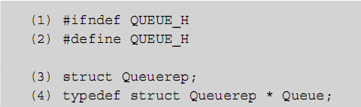
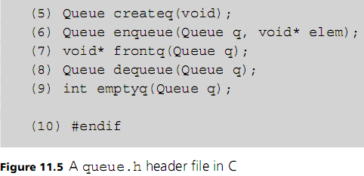
Separate Compilation in C and C++ (cont’d.)
Programming Languages, Third Edition

Slide 32
Separate Compilation in C and C++ (cont’d.)
Definition of the Queue data type is hidden in the implementation by defining Queue to be a pointer type
  Leaves the actual queue representation structure as an incomplete type
  Eliminates the need to have the entire Queue structure declared in the header file
The effectiveness of this mechanism depends solely on convention
  Neither compilers nor linkers enforce any protections or checks for out-of-date source code
Programming Languages, Third Edition

Slide 33
C++ Namespaces and Java Packages
namespace mechanism in C++ provides support for the simulation of modules in C
  Allows the introduction of a named scope explicitly
  Helps avoid name clashes among separately compiled libraries
Three ways to use the namespace:
  Use the scope resolution operator (::)
  Write a using declaration for each name from the namespace
  “Unqualify” all names in the namespace with a single using namespace declaration
Programming Languages, Third Edition

Slide 34
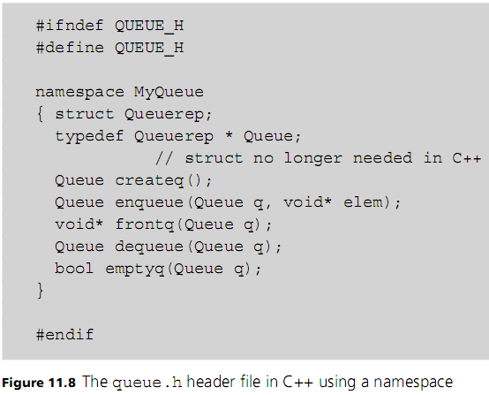
Programming Languages, Third Edition

Slide 35
C++ Namespaces and Java Packages (cont’d.)
Java has a namespace-like mechanism called the package:
  A group of related classes
Can reference a class in a package by:
  Qualifying the class name with the dot notation
  Using an import declaration for the class or the entire package
Java compiler can access any other public Java code that is locatable using the search path
Compiler will check for out-of date source files and recompile all dependent files automatically
Programming Languages, Third Edition

Slide 36
Ada Packages
Ada’s module mechanism is the package
  Used to implement modules and parametric polymorphism
Package is divided into two parts:
  Package specification: the public interface to the package, and corresponds to the signature of an ADT
  Package body
Package specifications and package bodies represent compilation units in Ada and can be compiled separately
Programming Languages, Third Edition

Slide 37
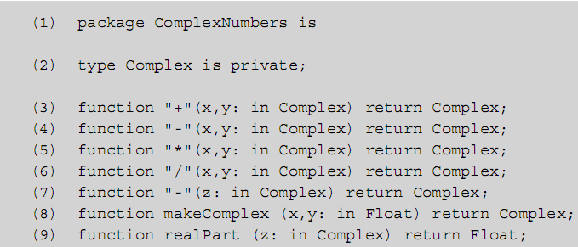
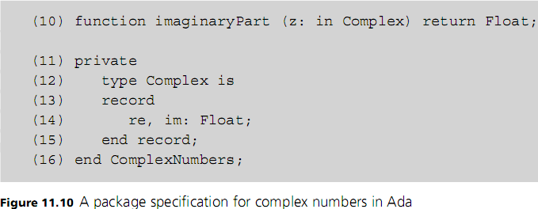
Programming Languages, Third Edition

Slide 38
Ada Packages (cont’d.)
Any declarations in a private section are inaccessible to a client
Type names can be given in the public part of a specification, but the actual type declaration must be given in the private part of the specification
This violates the two criteria for abstract data type mechanisms:
  The specification is dependent on the implementation
  Implementation details are divided between the specification and the implementation
Programming Languages, Third Edition

Slide 39
Ada Packages (cont’d.)
Packages in Ada are automatically namespaces in the C++ sense
Ada has a use declaration analogous to the using declaration of C++ that dereferences the package name automatically
Generic packages: implement parameterized types
Programming Languages, Third Edition

Slide 40
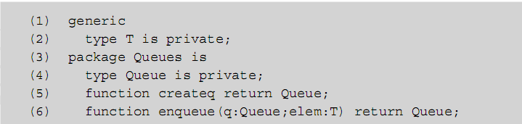
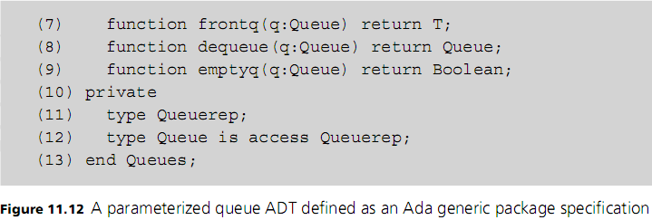
Ada Packages (cont’d.)
Programming Languages, Third Edition

Slide 41
Modules in ML
In addition to the abstract definition, ML has a more general module facility consisting of three mechanisms:
  Signature: an interface definition
  Structure: an implementation of the signature
  Functions: functions from structures to structures, with structure parameters having “types” given by signatures
Signatures are defined using the sig and end keywords
Programming Languages, Third Edition

Slide 42
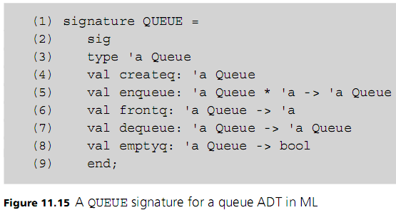
Modules in ML (cont’d.)
Programming Languages, Third Edition

Slide 43
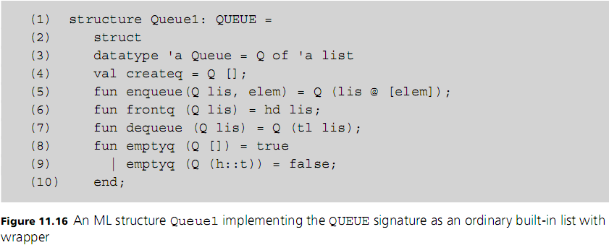
Modules in ML (cont’d.)
Programming Languages, Third Edition

Slide 44
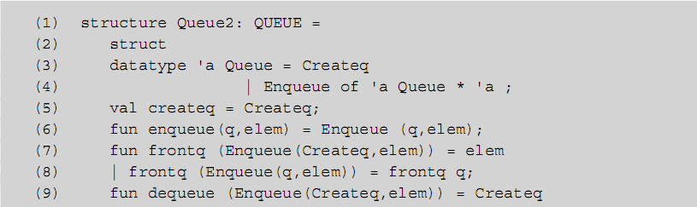
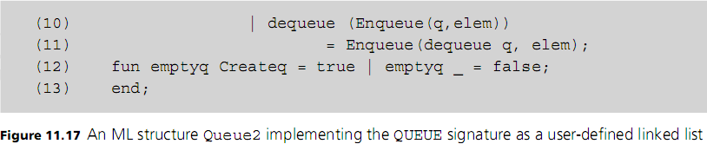
Modules in ML (cont’d.)
Programming Languages, Third Edition

Slide 45
Modules in ML (cont’d.)
ML signatures and structures satisfy most of the requirements for abstract data types
Main difficulty is that client code must explicitly state the implementation to be used in terms of the module name
  Code cannot be written to depend only on the signature, with the actual implementation structure to be supplied externally to the code
  This is because ML has no explicit or implicit separate compilation or code aggregation mechanism
Programming Languages, Third Edition

Slide 46
Modules in Earlier Languages
Historically, modules and abstract data type mechanisms began with Simula67
Languages that contributed significantly to module mechanisms in Ada and ML include CLU, Euclid, Modula-2, Mesa, and Cedar
Programming Languages, Third Edition

Slide 47
Euclid
In the Euclid programming language, modules are types
Must declare an actual object of the type to use it
When module types are used in a declaration, a variable of the module type is created, or instantiated
Can have two different instantiations of a module simultaneously
This differs from Ada or ML, where modules are objects instead of types, with a single instantiation of each
Programming Languages, Third Edition

Slide 48
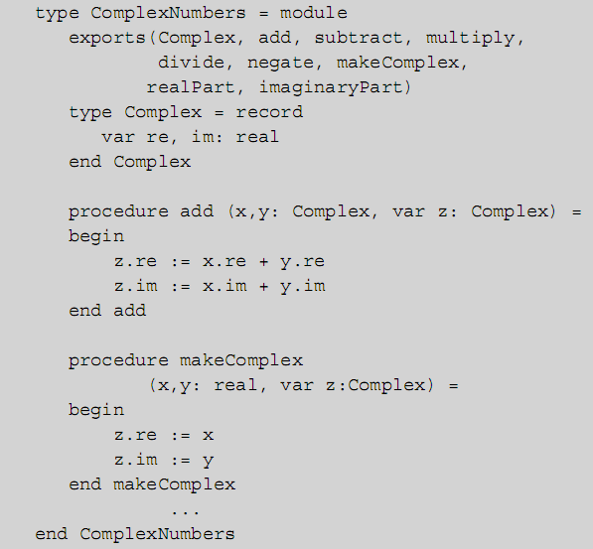
Programming Languages, Third Edition

Slide 49
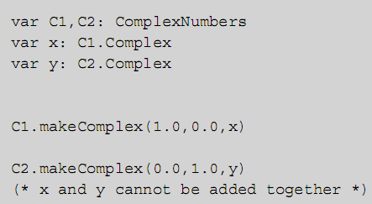
Euclid (cont’d.)
Programming Languages, Third Edition

Slide 50
CLU
In CLU, modules are defined using the cluster mechanism
The data type is defined directly as a cluster
When we define a variable, its type is not a cluster but what is given by the rep declaration
A cluster in CLU refers to two different things:
  The cluster itself
  Its internal representation type
Programming Languages, Third Edition

Slide 51
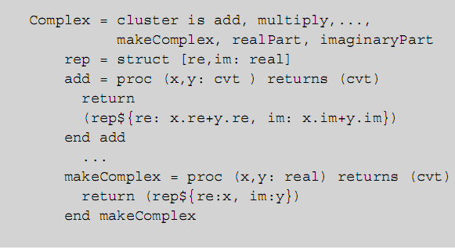
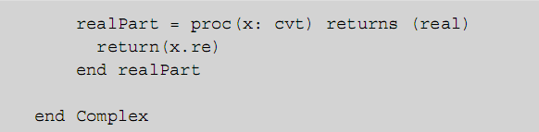
CLU (cont’d.)
Programming Languages, Third Edition

Slide 52
CLU (cont’d.)
cvt (for convert) converts from the external type (with no explicit structure) to the internal rep type and back again
Programming Languages, Third Edition

Slide 53
Modula-2
In Modula-2, the specification and implementation of an abstract data type are separated into a DEFINITION MODULE and an IMPLEMENTATION MODULE
DEFINITION MODULE: contains only definitions or declarations
  These are the only declarations that are exported (usable by other modules)
IMPLEMENTATION MODULE: contains the implementation code
Programming Languages, Third Edition

Slide 54
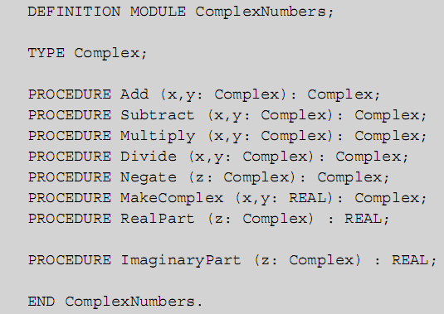
Modula-2 (cont’d.)
Programming Languages, Third Edition

Slide 55
Modula-2 (cont’d.)
A client module uses a data type by importing it and its functions from the data type’s module
Modula-2 uses the dereferencing FROM clause
  Imported items must be listed by name in the IMPORT statement
  No other items (imported or locally declared) may have the same names as those imported
Programming Languages, Third Edition

Slide 56
Problems with Abstract Data Type Mechanisms
Abstract data type mechanisms use separate compilation facilities to meet protection and implementation independence requirements
ADT mechanism is used as an interface to guarantee consistency of use and implementation
But ADT mechanisms are used to create types and associate operations to types, while separate compilation facilities are providers of services
  Services may include variables, constants, or other programming language entities
Programming Languages, Third Edition

Slide 57
Problems with Abstract Data Type Mechanisms (cont’d.)
Thus, compilation units are in one sense more general than ADT mechanisms
They are less general in that the use of a compilation unit to define a type does not identify the type with the unit
  Thus, not a true type declaration
Also, units are static entities that retain their identity only before linking
  Can result in allocation and initialization problems
Programming Languages, Third Edition

Slide 58
Problems with Abstract Data Type Mechanisms (cont’d.)
Using separate compilation units to implement abstract data types is therefore a compromise in language design
It is a useful compromise
  Reduces the implementation question for ADTs to one of consistency checking and linkage
Programming Languages, Third Edition

Slide 59
Modules Are Not Types
In C, Ada, and ML, problems arise because a module must export a type as well as operations
Would be helpful to define a module to be a type
  Would prevent the need to arrange to protect the implementation details with an ad hoc mechanism such as incomplete or private declarations
ML makes this distinction by containing both an abstype and a module mechanism
Module mechanism is more general, but a type must be exported
Programming Languages, Third Edition

Slide 60
Modules Are Not Types (cont’d.)
abstype is a data type, but its implementation cannot be separated from its specification
  Access to the details of the implementation is prevented
Clients of the abstype implicitly depend on the implementation
Programming Languages, Third Edition

Slide 61
Modules Are Static Entities
An attractive possibility for implementing an abstract data type is to simply not reveal a type at all
  Avoids possibility of clients depending in any way on implementation details
  Prevents clients from misuse of a type
Can create a package specification in Ada in which the actual data type is buried in the implementation
  This is pure imperative programming
Programming Languages, Third Edition

Slide 62
Modules Are Static Entities (cont’d.)
Normally this would imply that only one entity of that data type could be in the client
  Otherwise, the entire code must be replicated
This is due to the static nature of most module mechanisms
In Ada, the generic package mechanism offers a way to obtain several entities of the same type by using multiple instantiations of the same generic package
Programming Languages, Third Edition

Slide 63
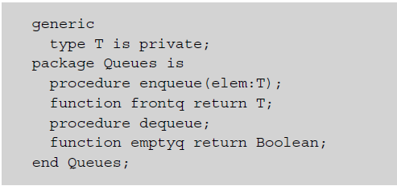
Modules Are Static Entities (cont’d.)
Programming Languages, Third Edition

Slide 64
Modules That Export Types Do Not Adequately Control Operations on Variables of Such Types
In the C and Ada examples given, variables of an abstract type had to be allocated and initialized by calling a procedure in the implementation
  The exporting module cannot guarantee that the initializing procedure is called before the variable is used
Also allows copies to be made and deallocations performed outside the control of the module
  Without the user being aware of the consequences
  Without the ability to return deallocated memory to available storage
Programming Languages, Third Edition

Slide 65
Modules That Export Types Do Not Control Operations (cont’d.)
In C, x:=y performs assignment by sharing the object pointed to by y
  x=y tests pointer equality, which is not correct when x and y are complex numbers
In Ada, we can use a limited private type as a mechanism to control the use of assignment and equality
  Clients are prevented from using the usual assignment and equality operations
  Package ensures that equality is performed correctly and that assignment deallocates garbage
Programming Languages, Third Edition

Slide 66
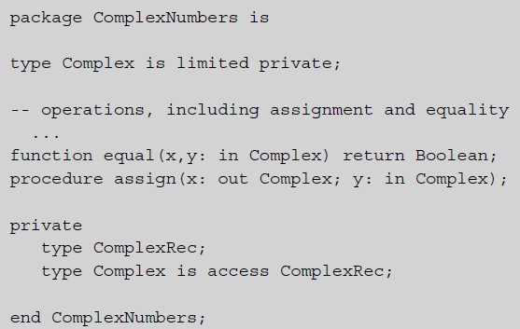
Modules That Export Types Do Not Control Operations (cont’d.)
Programming Languages, Third Edition

Slide 67
Modules That Export Types Do Not Control Operations (cont’d.)
C++ allows overloading of assignment and equality
Object-oriented languages use constructors to solve the initialization problem
ML limits the data type in an abstype or struct specification to types that do not permit the equality operation
  Type parameters that allow equality testing must be written with a double apostrophe ‘’a instead of a single apostrophe ‘a
Programming Languages, Third Edition

Slide 68
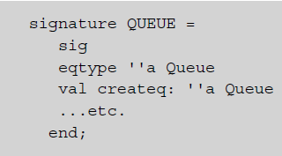
Modules That Export Types Do Not Control Operations (cont’d.)
In ML, types that allow equality must be specified as eqtype
  Example:
Programming Languages, Third Edition

Slide 69
Modules Do Not Always Adequately Represent Their Dependency on Imported Types
Modules often depend on the existence of certain operations on type parameters
  May also call functions whose existence is not made explicit in the module specification
Example: data structures such as binary search tree, priority queue, or ordered list all required an order operation such as the less-than arithmetic operation “<“
C++ templates mask such dependencies in specifications
Programming Languages, Third Edition

Slide 70

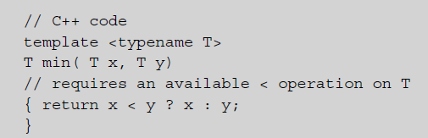
Modules Do Not Always Represent Their Dependency (cont’d.)
Example: in C++ code
  Template min function specification
  Implementation shows the dependency
Programming Languages, Third Edition

Slide 71
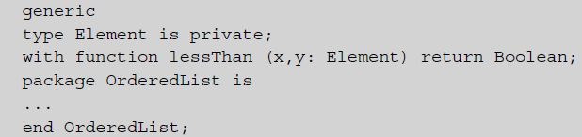

Modules Do Not Always Represent Their Dependency (cont’d.)
In Ada, can specify this requirement using additional declarations in the generic part of a package declaration:
Instantiation must provide the lessThan function:
Programming Languages, Third Edition

Slide 72
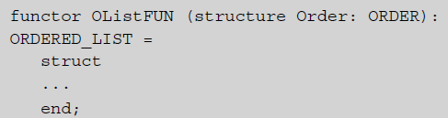
Modules Do Not Always Represent Their Dependency (cont’d.)
Such a requirement is called constrained parameterization
ML allows structures to be explicitly parameterized by other structures
  This feature is called a functor (a function on structures)
Programming Languages, Third Edition

Slide 73

Modules Do Not Always Represent Their Dependency (cont’d.)
The functor can be applied to create a new structure:
This makes explicit the appropriate dependencies, but at the cost of requiring an extra structure to be defined that encapsulates the required features
Programming Languages, Third Edition

Slide 74
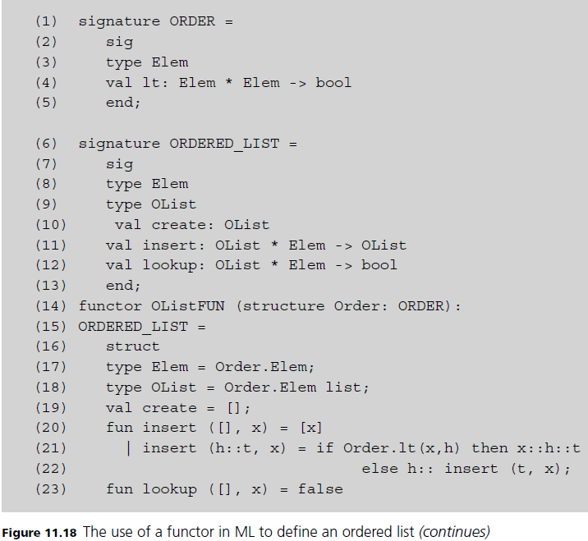
Programming Languages, Third Edition

Slide 75
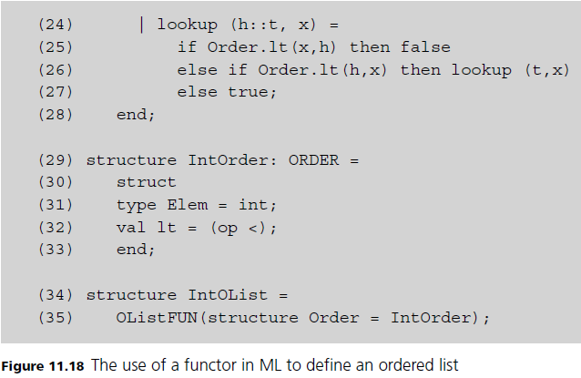
Modules Do Not Always Represent Their Dependency (cont’d.)
Programming Languages, Third Edition

Slide 76
Module Definitions Include No Specification of the Semantics of the Provided Operations
In almost all languages, no specification of the behavior of the available operations of an abstract data type is required
The Eiffel object-oriented language does allow the specification of semantics
  Semantic specifications are given by preconditions, postconditions, and invariants
Preconditions and postconditions establish what must be true before and after the execution of a procedure
Programming Languages, Third Edition

Slide 77
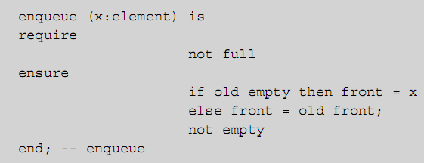
Module Definitions Include No Specification of Semantics (cont’d.)
Invariants establish what must be true about the internal state of the data in an abstract data type
Example: the enqueue operation in Eiffel:
Programming Languages, Third Edition

Slide 78

Module Definitions Include No Specification of Semantics (cont’d.)
require section establishes preconditions
ensure section establishes postconditions
These requirements correspond to the algebraic axioms:
Programming Languages, Third Edition

Slide 79
The Mathematics of Abstract Data Types
An abstract data type is said to have existential type
  It asserts the existence of an actual type that meets its requirements
An actual type is a set with operations of the appropriate form
  A set and operations that meet the specification are a model for the specification
It is possible for no model to exist, or many models
Programming Languages, Third Edition

Slide 80
The Mathematics of Abstract Data Types (cont’d.)
Potential types are called sorts, and potential sets of operations are called signatures
  Thus a sort is the name of a type not yet associated with any actual set of values
  A signature is the name and type of an operation or set of operations that exists only in theory
A model is then an actualization of a sort and its signature and is called an algebra
Algebraic specifications are often written using the sort-signature terminology
Programming Languages, Third Edition

Slide 81
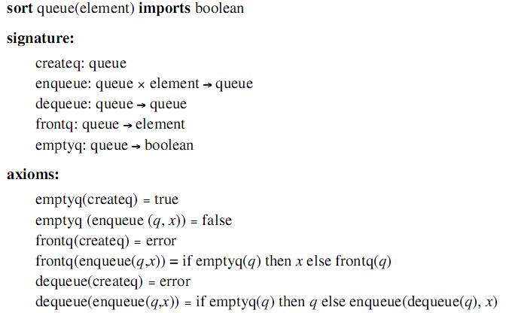
The Mathematics of Abstract Data Types (cont’d.)
Programming Languages, Third Edition

Slide 82
The Mathematics of Abstract Data Types (cont’d.)
We would like to be able to construct a unique algebra for the specification to represent the type
Standard method to do this:
  Construct the free algebra of terms for a sort
  Form the quotient algebra of the equivalence relation generated by the equational axioms
Free algebra of terms consists of all legal combinations of operations
Programming Languages, Third Edition

Slide 83
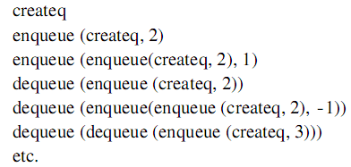
The Mathematics of Abstract Data Types (cont’d.)
Example: free algebra for sort queue(integer) and signature shown earlier includes:
Note that the axioms for a queue imply that some terms are actually equal:
Programming Languages, Third Edition

Slide 84

The Mathematics of Abstract Data Types (cont’d.)
In the free algebra, no axioms are true
  To make them true (to construct a type that models the specification), must use axioms to reduce the number of distinct elements in the free algebra
This can be done by constructing an equivalence relation == from the axioms
  “==“ is an equivalence relation if it is symmetric, transitive, and reflexive:
Programming Languages, Third Edition

Slide 85
The Mathematics of Abstract Data Types (cont’d.)
Given an equivalence relation == and a free algebra F, there is a unique well-defined algebra F/== such that x=y in F/== if and only if x==y in F
  The algebra F/== is called the quotient algebra of F by ==
  There is a unique “smallest” equivalence relation making the two sides of every equation equivalent and hence equal in the quotient algebra
The quotient algebra is usually taken to be the data type defined by an algebraic specification
Programming Languages, Third Edition

Slide 86
The Mathematics of Abstract Data Types (cont’d.)
This algebra has the property that the only terms that are equal are those that are provably equal from the axioms
This algebra is called the initial algebra represented by the specification
  Using it results in what are called initial semantics
In general, axiom systems should be consistent and complete
  Another desirable property is independence: no axiom is implied by other axioms
Programming Languages, Third Edition

Slide 87
The Mathematics of Abstract Data Types (cont’d.)
Deciding on an appropriate set of axioms is generally a difficult process
Final algebra: an approach that assumes that any two data values that cannot be distinguished by inspector operations must be equal
  The associated semantics are called final semantics
A final algebra is also essentially unique
Principle of extensionality in mathematics:
  Two things are equal precisely when all their components are equal
Programming Languages, Third Edition

